Slide 1

Semiparametric regression in predictmeans
Dongwen Luo
Notes:
Good afternoon!
My name is Dongwen Luo from AgResearch NZ, here I would like to talk about semi-parametric regression in R package ‘predictmeans’

Slide 2
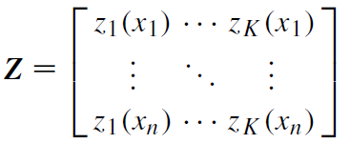
Motivation
Semiparametric regression provides a flexible combination of parametrical and non-parametrical effects for predict variables.
Semiparametric regression has proven to be of great value in many applications in fields as diverse as astronomy, biology, medicine, economics, and finance.
Semiparametric regression can be represented as a mixed effects model:
Notes:
The motivation for this is due to the flexibility of semiparametric regression and its wide application. Especially, semiparametric regression can be represented as a mixed effects model using spline bases in Z matrix

Slide 3
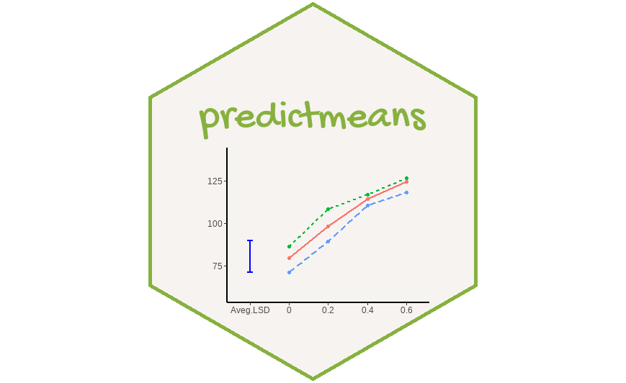
Semiparametric Regression
semireg
semipred
Notes:
R package 'predictmeans' is used to visualize, diagnose and make inferences for mixed effects model. Therefore, I have developed several new functions to do the similar things for semiparametric regression.

Slide 4
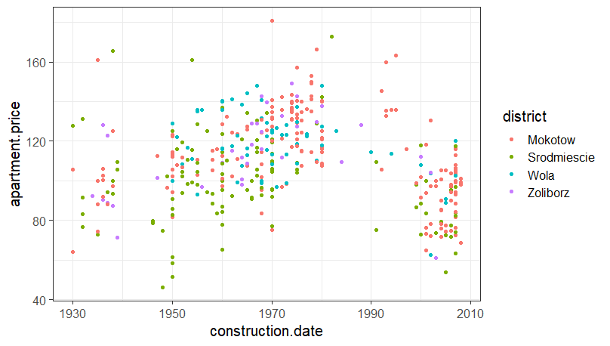
Example
Notes:
Let’s have a look the first example for the data of apartment price vs construction date from four districts.. Here we want to find the trend of the price along the date. From the plot we can see it is hard to use any parametric model to catch the interested trend.

Slide 5
Example
> fit1 <- semireg(apartment.price ~ construction.date,
+ smoothZ=list(
+ grp=smZ(construction.date, k=25, type=‘ZOSull’)
+ ),
+ data = WarsawApts)
> fit1$semer
Linear mixed model fit by REML ['lmerModLmerTest']
Formula: apartment.price ~ construction.date + (1 | grp)
Data: WarsawApts
REML criterion at convergence: 3538.815
Random effects:
Groups Name Std.Dev.
grp (Intercept) 114.69
Residual 17.81
Number of obs: 409, groups: grp, 27
Fixed Effects:
(Intercept) construction.date
109.387 1.406
predictmeans::residplot(fit1$semer)
lmerTest::nova(fit1$semer)
lmerTest::ranova(fit1$semer)
Notes:
To fit a semiparametric regression, we use function ‘semireg’ in the package. Here we have response of price and predictor date, and for smooth Z we use O'Sullivan (O sulervan) type of spline. The fitted result actually is a mer object with random effect of ‘grp’ specified in smooth Z. Therefore, we can use other functions in ‘predictmeans’ or any packages relating to ‘lme4’ to diagnose or make inference such as …

Slide 6
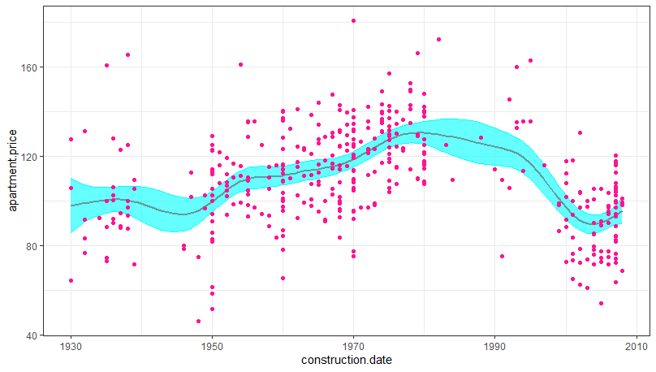
sp_out1 <- semipred(fit1, covariate = "construction.date")

Slide 7
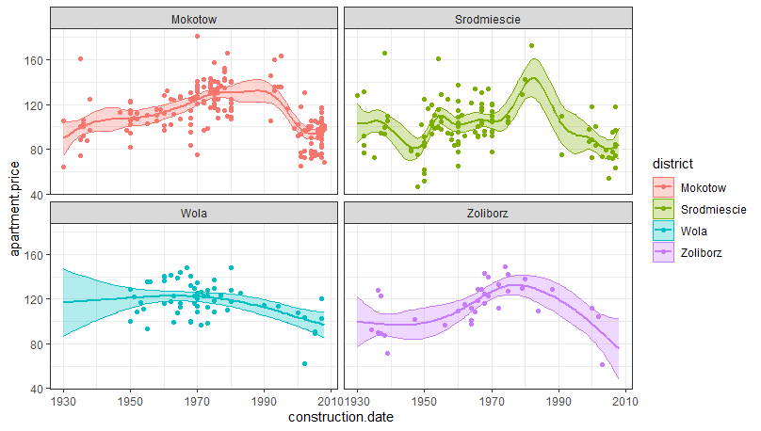
fit2 <- semireg(apartment.price ~ construction.date*district,
smoothZ=list(grp=smZ(construction.date, k=15,
by = district, group=TRUE)),
data=WarsawApts)
sp_out2_1 <- semipred(fit2, modelterm="district",
covariate="construction.date")

Slide 8
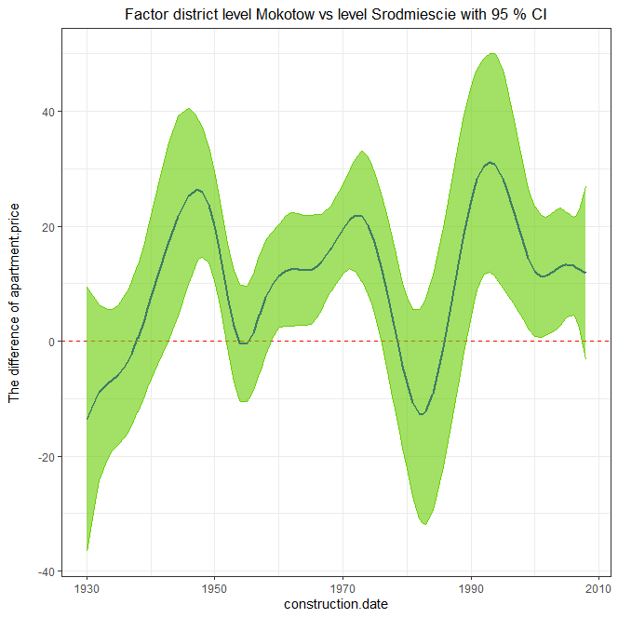
sp_out2_2 <- semipred(fit2, "district", "construction.date", contr=c(1,2))

Slide 9
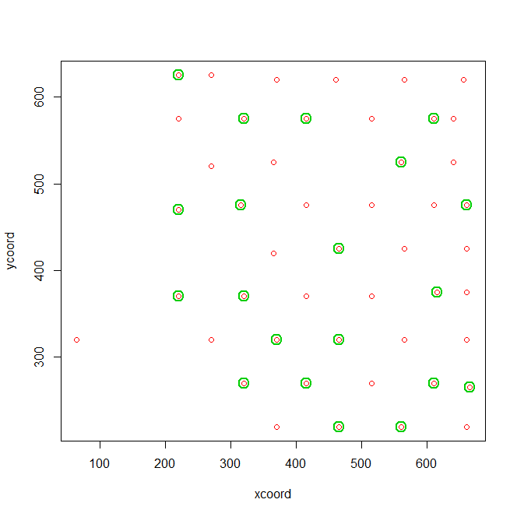
Example
> str(copper)
'data.frame': 439 obs. of 4 variables:
$ xcoord: int 220 220 220 220 220 220 220 220 220 270 ...
$ ycoord: int 625 625 625 625 625 625 625 625 625 625 ...
$ zcoord: int 122 117 112 107 102 97 92 87 82 122 ...
$ grade : num 1.34 0.98 1.29 1.18 1.1 0.46 1.18 0.96 1.27 0.64
Notes:
Let’s have a look the second example about copper grade with their mined location measured in three coordinates.

Slide 10
> fit3 <- semireg(log(grade) ~ xcoord+ycoord+zcoord,
+ smoothZ=list(grp_z=smZ(zcoord),
+ grp_geo=smZ(cbind(xcoord, ycoord),
+ intKnots=copperKnots_sd,
+ type="Ztps")),
+ data=copper)
Linear mixed model fit by REML ['lmerModLmerTest']
Formula:
log(grade) ~ xcoord + ycoord + zcoord + (1 | grp_z) + (1 | grp_geo)
Data: copper
REML criterion at convergence: 258.4551
Random effects:
Groups Name Std.Dev.
grp_geo (Intercept) 0.1496
grp_z (Intercept) 0.8569
Residual 0.3010
Number of obs: 439, groups: grp_geo, 20; grp_z, 8
Fixed Effects:
(Intercept) xcoord ycoord zcoord
-0.20903 -0.48209 -0.02705 0.03757

Slide 11
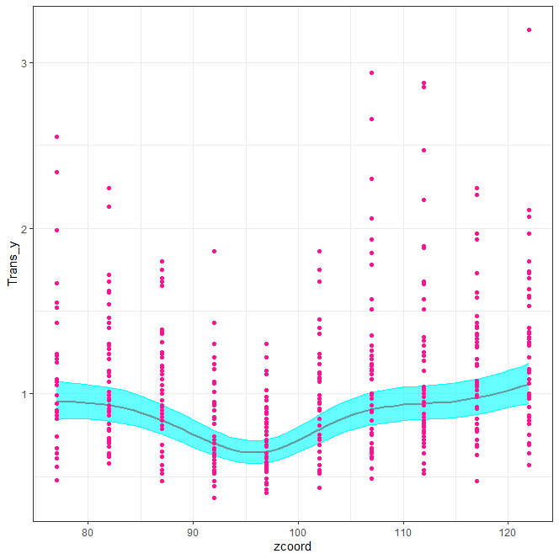
semipred(fit3, covariate="zcoord", trans=exp)

Slide 12
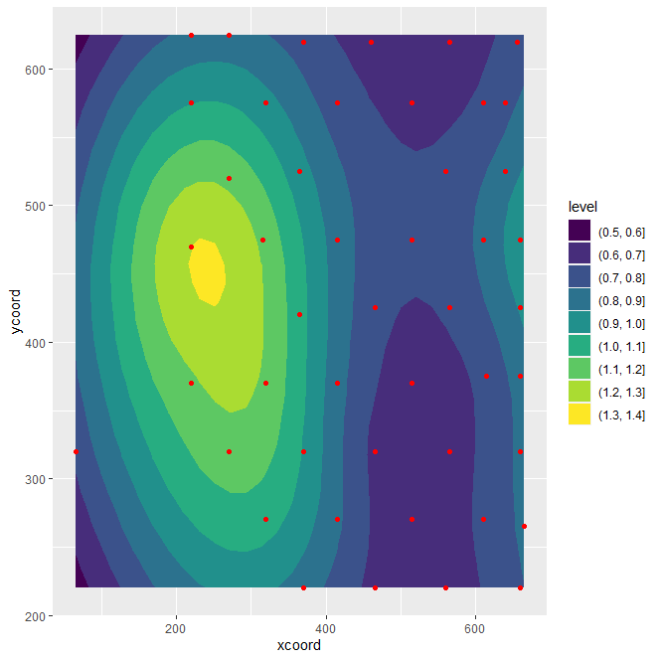
plot2D_out <- semipred(fit3, covariate=c("xcoord", "ycoord"),
threeD=FALSE, point=TRUE, trans=exp)

Slide 13
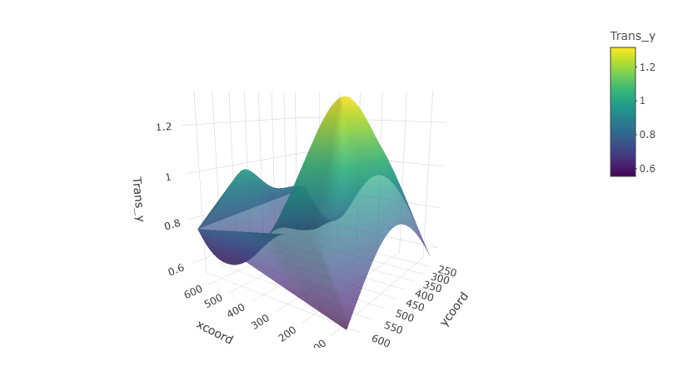
plot3D_out <- semipred(fit3, covariate=c("xcoord", "ycoord"), threeD=TRUE, point=FALSE, trans=exp)

Slide 14
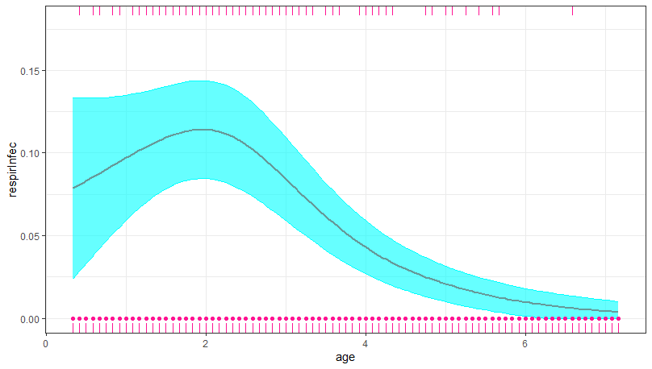
Example
fit4 <- semireg(respirInfec ~ age+vitAdefic + sex + height +
stunted + visit2 + visit3 + visit4 + visit5 +
visit6+(1|idnum),
smoothZ=list(grp=smZ(age, k=25)),
family = binomial,
data = indonRespir)
sp_out4 <- semipred(fit2, covariate = "age")
Notes:
Respiratory (reSPIRetry, res-per-rah-tree) infection in Indonesian children

Slide 15
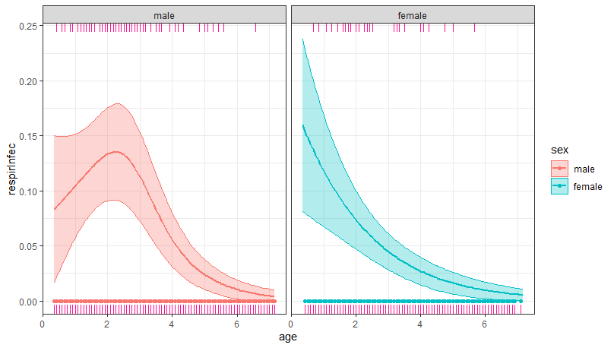

Slide 16
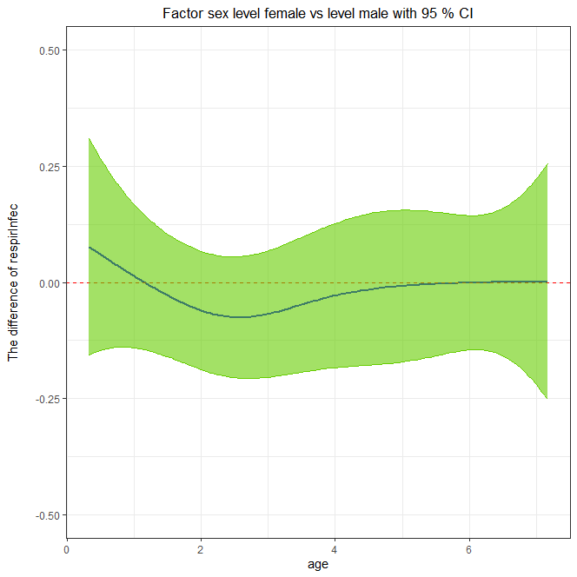

Slide 17
Summary
Three new functions have been added in R package 'predictmeans' (named 'smZ', 'semireg' and 'semipred') for fitting, visualizing (2D or 3D) and inferencing a semi-parametric regression using 'lme4' framework.

Slide 18
Reference
Ruppert, D., Wand, M.P. and Carroll, R.J. (2003). Semiparametric Regression. Cambridge, U.K.: Cambridge University Press.
Harezlak, J., Ruppert, D. and Wand, M.P. (2018). Semiparametric Regression with R. Springer, ISBN: 978-1-4939-8851-8).
Luo, D., Ganesh, S., & Koolaard, J. (2022). Predictmeans: calculate predicted means for linear models [R package version 1.0.8]. https://CRAN.R-project.org/package=predictmeans.

